Slide 1

Students’ Early Attrition Modelling for Clearwater State University

Slide 2
Goals & Objectives
Clearwater State University offers a wide variety of degree programs, from online degrees to a doctorate in education. Programs are offered in the streams of the arts, education, business nursing
Problem Area: Students Early Attrition
Students dropping out within one year of joining the program
1. Identify key drivers of early student attrition
2. Build a predictive model to identify students with higher
early attrition risk
3. Recommend appropriate interventions based on the analysis

Slide 3
Identification of Key Drivers
After analysis created with critical factors which are significant for the student who left and these critical factors are taken from histogram analysis, box plot and pandas profiling...
Distance from home is longer
Family contribution is less
Unmet needs are high
High-school GPA is less
Father /Mother education varies
After comparing with mean of each variable it comes to notice that above 5 parameter mean has a greater variance in the event 0 & event 1

Slide 4
EXPLORATORY ANALYSIS:
Flow Chart
Gathering or Understanding the Data by Exploratory Analysisi
Defining the Model & before implementing the model
Have Split the data in Train data set as 70% & Test Data Set as 30%
To stimulate the entire data which is used for bulilding the model prediction
Data Balancing is done using SMOTE
Training testing the model & predicting the output
Cleaning the Data
Looking at various factors like
Missing Values
Unique Values
Skewness of the variables in the data &
Treating all of them
Feature Engineering Some Features are found highly skewed it includes, STDNT_AGE, DISTANCE_FROM_HOME that are been normalised
Missing Values Being Imputed respectively by mean, mode
Some Features that are not related or are extra degrade the performance of the model so are removed

Slide 5
Exploratory Analysis
Highly correlated independent variables are been removed only one independent variable is kept
Some Features are found highly skewed it includes, STDNT_AGE, DISTANCE_FROM_ HOME that are been normalised
Features having high number of missing values, above 25% have been dropped which can bias our analysis
Missing values have been appropriately imputed by mean , median & mode like numeric continuous variable like GPA are being imputed by mean
Event ‘0’ that was left/attrited students was converted to Event ‘1’ & vice versa As as python consider only 1 for modelling
High Unique Values like student Identifier are dropped Outliers are treated by some observations being dropped
To counter the imbalanced dataset problem have used SMOTE bagging.

Slide 6
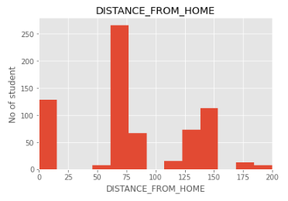
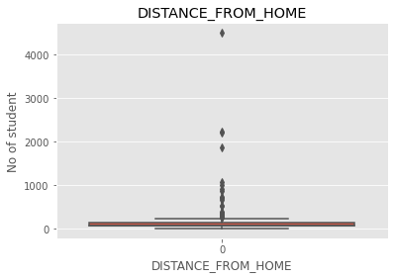

Imp Features affecting the Attrition
Above plot shows maximum number of students who left college are staying between 60 to 80 Km away from college
Outliers are more in the overall data & Data was highly skewed
Few students left are far away from the college also
Average distance from home in Left students is found from 60km to 80km

Slide 7
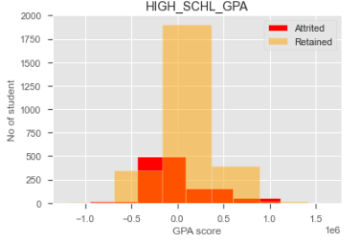
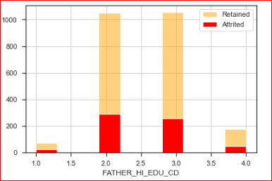
Imp Features affecting the Attrition
Avg High school GPA has lower attrite rate of students compared to the retained ones & Left students have negative & less score
Father_HI_EDU_CD –Father education at higher school levels does not affect or make any major impact on the drop out level of students in second year

Slide 8
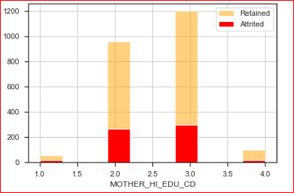
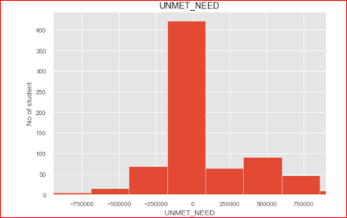
Imp Features affecting the Attrition
Mother education at high school level does not affect or make any major impact on the drop out level of students in second year
Unmet Needs are high in
the students who have
attrited or left
This shows there is a lack
of financial support in the
students attrited or left

Slide 9
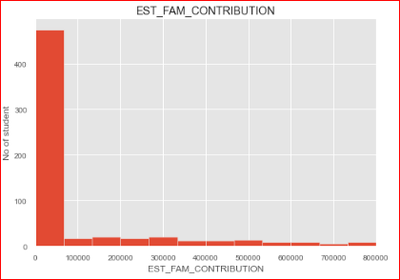
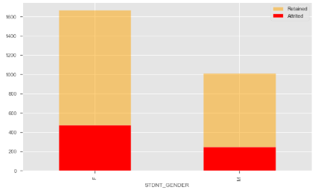
Imp Features affection the Attrition
EST_FAM_CONTRIBUTION
shows Maximum students who left are because of low or no Family Contribution
STDNT_GEN shows Maximum Female students who enrolled were 2140 & Males were 1260 Females left 475 ie 14% attrited & 248 Males left ie 7.3% attrited

Slide 10
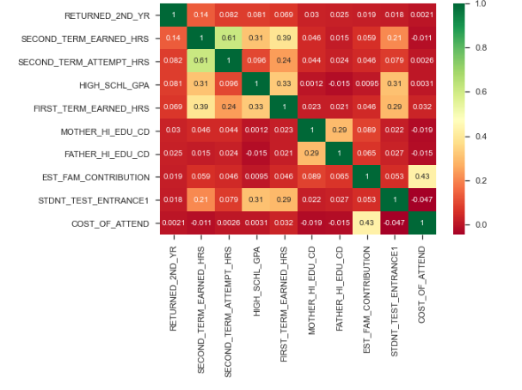
Correlation of variables
For Feature Importance ,& selecting most impacting features have used basic Forward Selection method firstly, then have applied Univariate Selection by using the best Correlation matrix & Heat maps
Here it’s in between the range 0.0 to 1.0 the higher the values is higher the correlation between the dependent & independent with the target variable ex:
Second Term Earned Hours & Attempt hours are highly correlated with each other

Slide 11
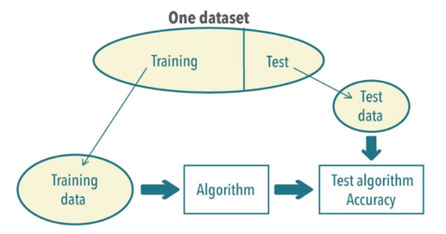
Splitting data into Training and Testing sets
Prior to the implementation or applying any Machine Learning algorithms, we must decouple training and testing datasets from our Master Data frame.
As train/test is used to measure the accuracy of model
And are used to simulate the entire data..which will be used for building model for prediction
Hence have stratified by split Test data to 30% & Train data set of 70% & to simulate & keep the data result constant have set the random state
30%
70%

Slide 12
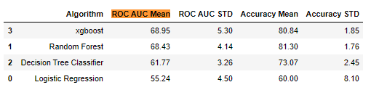
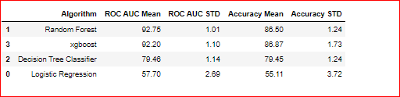
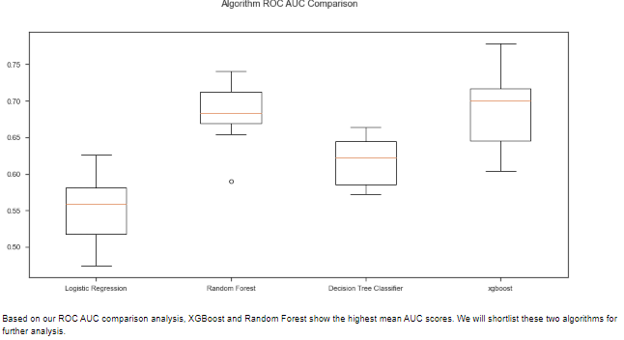
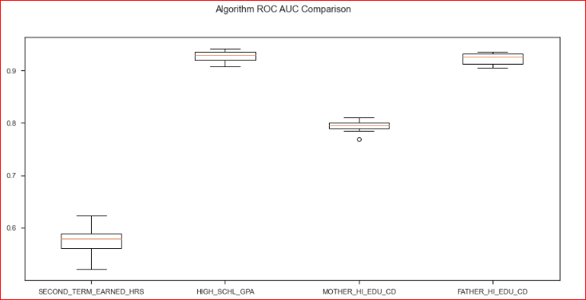
Model Building for Prediction
Applied Machine Building Algorithms
To estimate the skill of a machine learning models on unseen data. For better model prediction Cross Validation is used . Hence have imported K fold from sklearn.model_selection for selection of algorithms to consider and set the performance measure. Also to deal with the class imbalance have used SMOTE Hence have evaluated each model using cross-validation
BEFORE SMOTE AFTER SMOTE

Slide 13
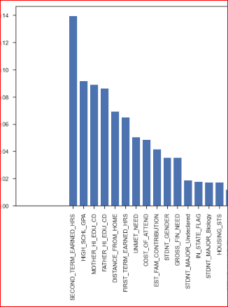
Feature Selection
Important Feature Selection
Feature Importance ,& selecting most impacting features according to Random Forest
Random Forest helped us identify the Top 10 most important indicators (ranked as in the chart) as:
Second term earned hours,
High_Schl_GPA
Mother_Hi_Edu_CD
Father _Hi_Edu_CD
Distance_From_Home
First_Term_Earned_HRS
Unmet_Need
Cost_Of_Attend
Est_Fam_Contribution
STDNT_Gender

Slide 14
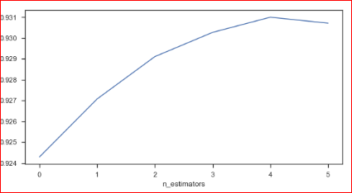
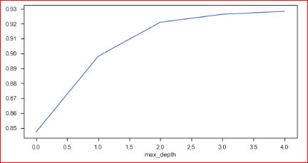
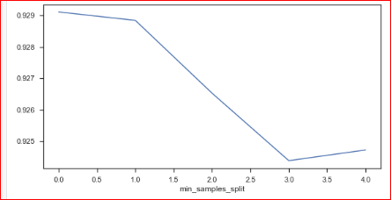
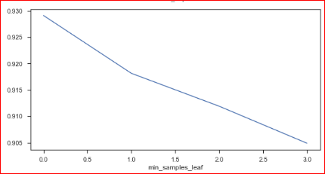
Hyper Parameter Tuning
Best Score : 0.929
Is -----0.926
-----0.928
Is ----0.928

Slide 15
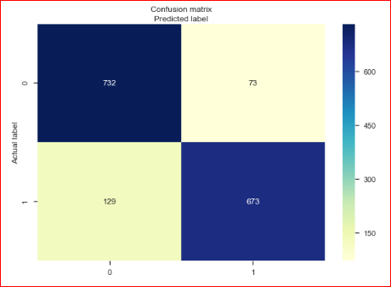
Confusion Matrix
Confusion Matrix:
A Confusion matrix is a summary of prediction results on a classification problem. The number of correct and incorrect predictions are summarized with count values and broken down by each class .
Classification Rate/Accuracy: Accuracy =
(TP + TN) / (TP + TN + FP + FN) = (732+673) /(673+ 732+ 73+ 129) = 0.88
Recall: Recall gives us an idea about when it’s actually yes, how often does it predict yes. Recall = TP / (TP + FN) 673 (673 + 129) =0.84
Precision: Precision tells us about when it predicts yes, how often is it correct. Precision = TP / (TP + FP)=673/ (673+73) = 0.90
F-1 score is the weighted average of Precision & Recall F-measure = (2 * Recall * Precision) / (Recall + Precision) = 2 *( 0.84 * 0.90) / (0.839 + 0.90) = 0.87

Slide 16
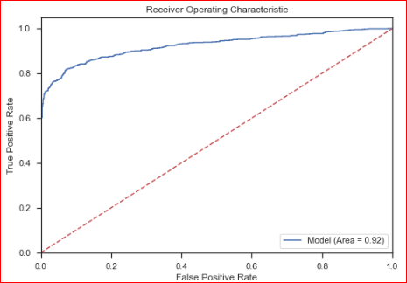


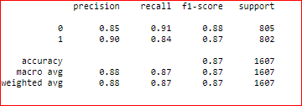
Trained Final Classifier Random Forest
Trained Final Classifier
Random Forest
ROC Graphs AUC - ROC curve is a performance measurement for classification problem at various thresholds settings. ROC is a probability curve and AUC represents degree or measure of separability. It tells how much model is capable of distinguishing between classes. The Blue line represents the ROC curve of a purely random classifier; a good classifier stays as far away from that line as possible (toward the top-left corner).
Confusion Matrix
Classification Report
Roc Curve for Random Forest Using probabilistic class prediction resulted in AUC score is: 0.929 which is higher than that best score during the optimisation step.

Slide 17
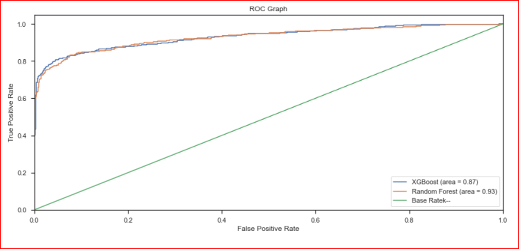
ROC Graph Comparison
Area under ROC Curve (or AUC for short) is a performance metric for binary classification problems. The AUC represents a model’s ability to discriminate between positive and negative classes. An area of 1.0 represents a model that made all predictions perfectly. An area of 0.5 represents a model as good as random
As Random Forest is found as best Model with Higher AUC = 0.93 We use this model on our Test Set

Slide 18
Conclusion
Following factors are affecting students’ early attrition
Graded Score Earned by Students in First Term & Second Term
COST/ FEES OF COURSE attained Not Affordable
Less or no Family contribution For Fees & More of Unmet needs
Long Distance from Home to University
HIGH SCHOOL GPA SCORE that was very low

Slide 19
Retention Strategies
Recommending appropriate interventions based on the analysis
Student's High School GPA score
Set minimum criteria that the cut off score that has to be above 3.0 or 2.5
Hours earned by student or Grade points earned by Student in First & Second semester
Grade Points earned by students to be encouraged by Awarding them exciting prizes or Certificates
Distance From Home & On Campus
Provide Some Transport Facility like Bus or any other means of transport from college to their homes especially for Long Distance students
Encourage & Provide On -Campus Hostel Facility with Good food / breakfast /rooms to live in. within affordable cost.
Cost of attend -- Course fees
Family Contribution & Unmet Needs
College should start trust funds to support such students by providing scholarships on Merit
Provide Education loan for continuation of the course who are having unmet needs & their family contribution is less than needed or have no support from Family
Introduce Advanced teaching methods like Smart TV (Digital)

Slide 20

Thank you!
By--- Vrunda Patel

